Slide 1
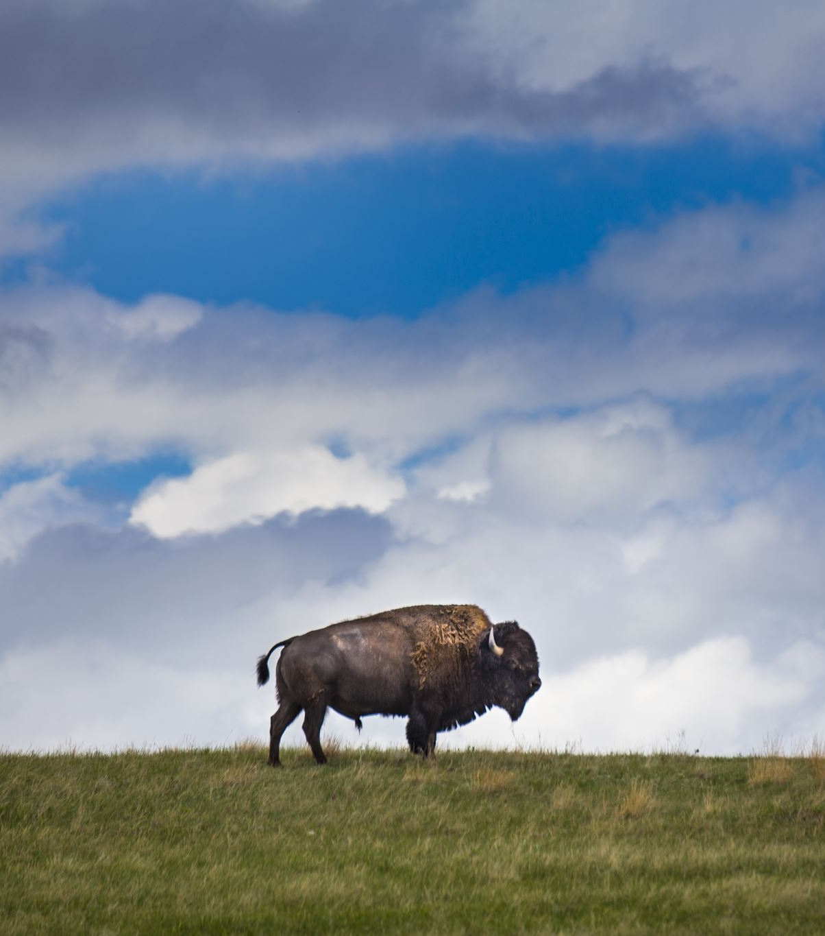
Impact of Bison in the Konza Prairie
Aftab, Raphael, and John Led by: Zech

Slide 2
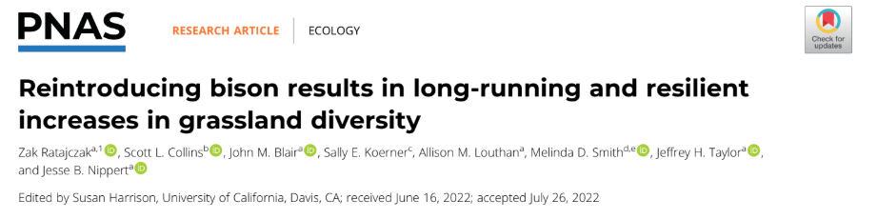
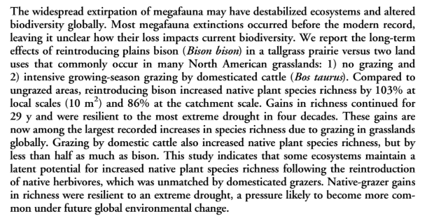
Konza Prairie:
Location: Eastern Kansas, USA (Northern Hemisphere) - largest remaining tallgrass prairie landscape in North America
Research Status: Long-Term Ecological Research (LTER) site established for studying Great Plains grassland ecology
Paper Findings:
Biodiversity Impact: Bison reintroduction increased native plant species richness by 103% at local scales compared to ungrazed areas, with gains continuing for 29 years
Resilience & Comparison: These biodiversity gains were resilient to extreme drought and represent some of the largest recorded increases in grassland species richness globally - cattle grazing increased richness by less than half as much as bison

Slide 3
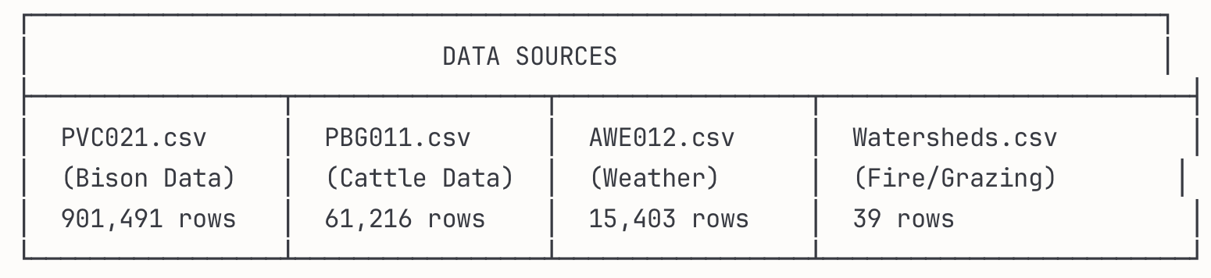
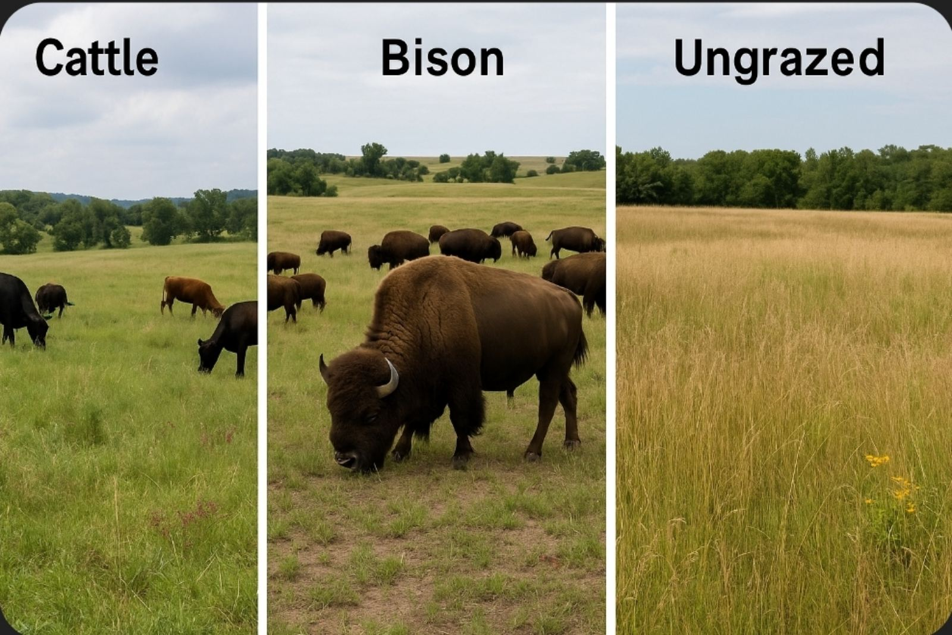
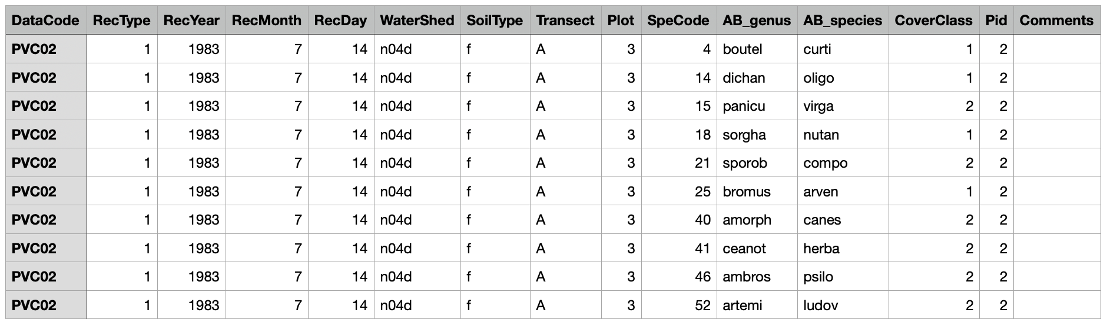
Transect: A fixed line used to record species data across a site.
CoverClass: A scale (1–7) estimating how much ground a plant species covers.

Slide 4
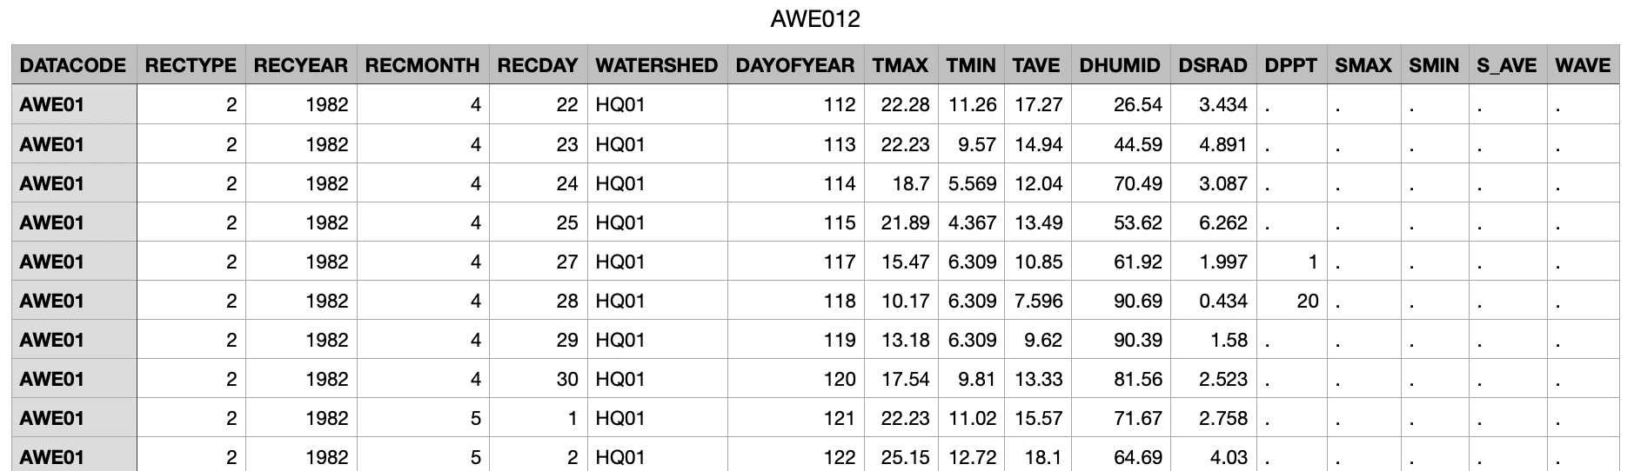
TAVE: Average daily temperature
DHUMID: Average daily humidity
DSRAD: Daily solar radiation
DPPT: Daily precipitation (rain)

Slide 5
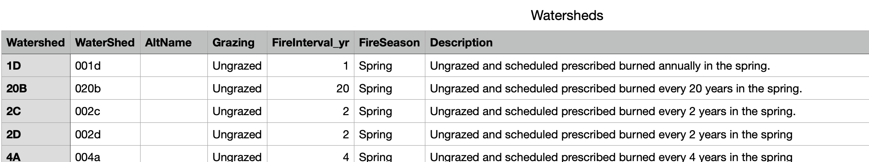
FireInterval_yr: How often prescribed burns occur in each watershed
FireSeason: When during the year controlled burns are conducted

Slide 6

Data Wrangling Goal
Integrate multiple ecological datasets into a unified analysis framework for studying bison impacts on grassland diversity
Create consistent plot tracking system using unique plot_ID (which encodes watershed, plot, transect, soil type, and date) to consistently track each sampling location over time
Link vegetation patterns with environmental drivers (climate, fire, grazing treatments) for comprehensive ecological analysis
Prepare analysis-ready dataset for statistical modeling and predictive analysis of grassland biodiversity responses

Slide 7
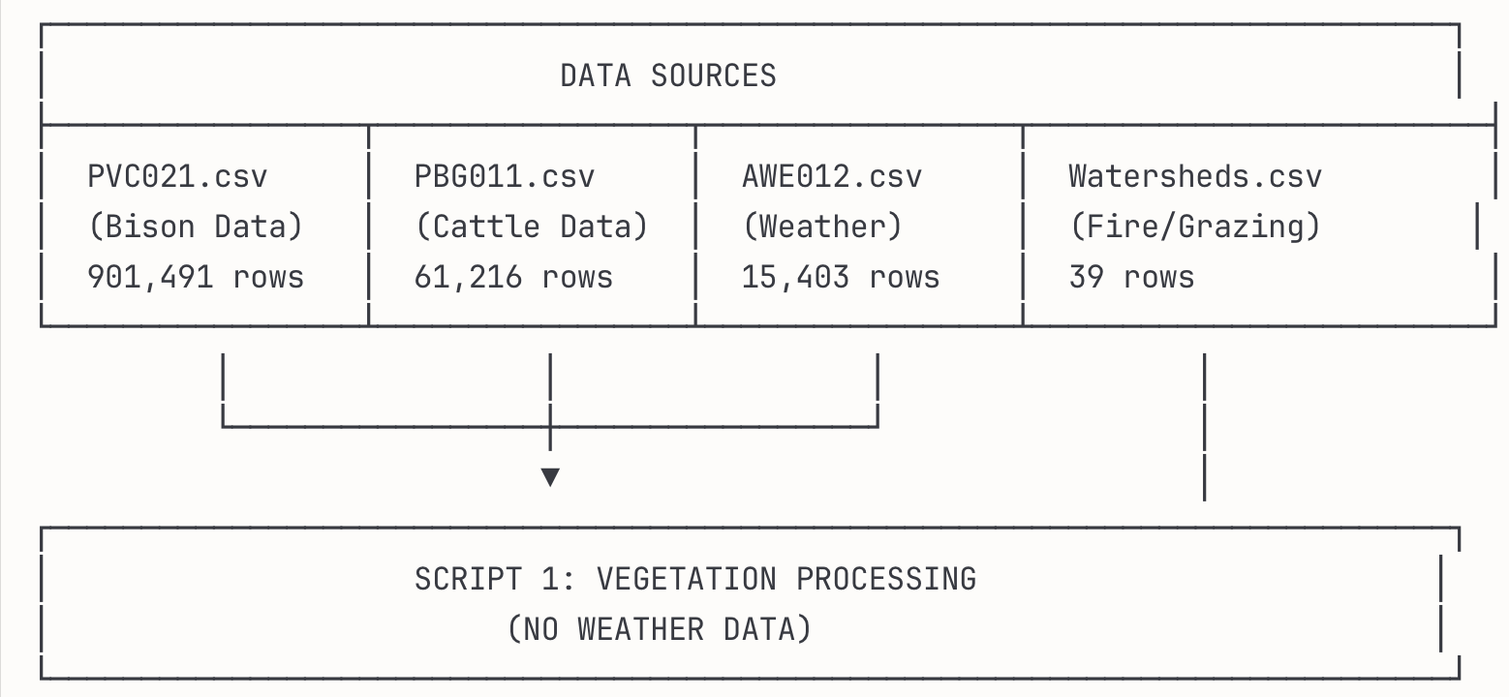
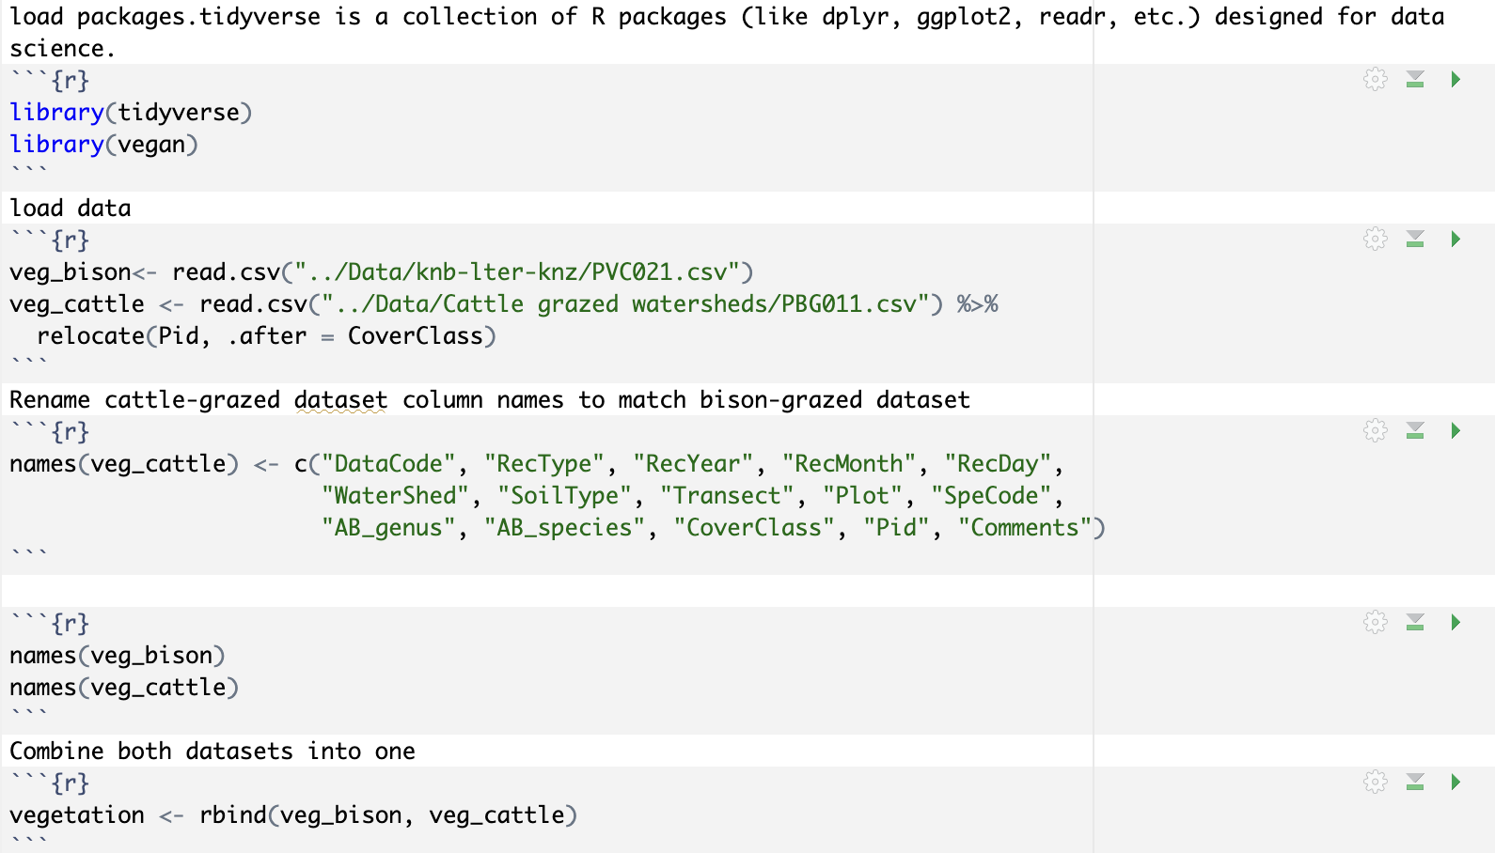
Data Wrangling: Script 1

Slide 8
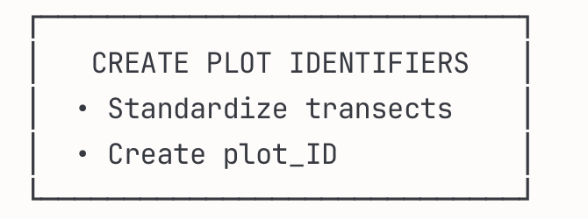
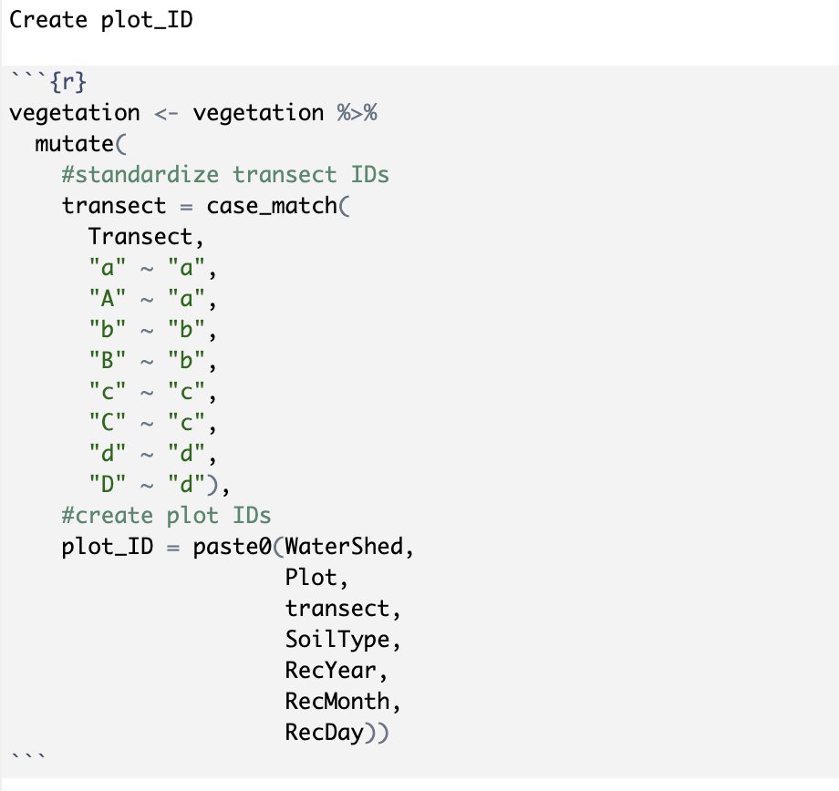
Data Wrangling: Script 1

Slide 9
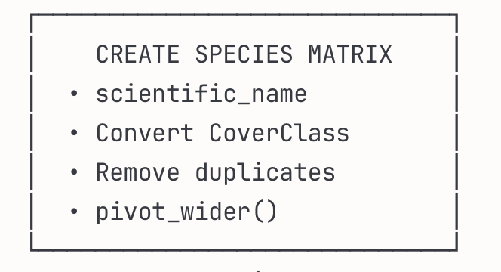
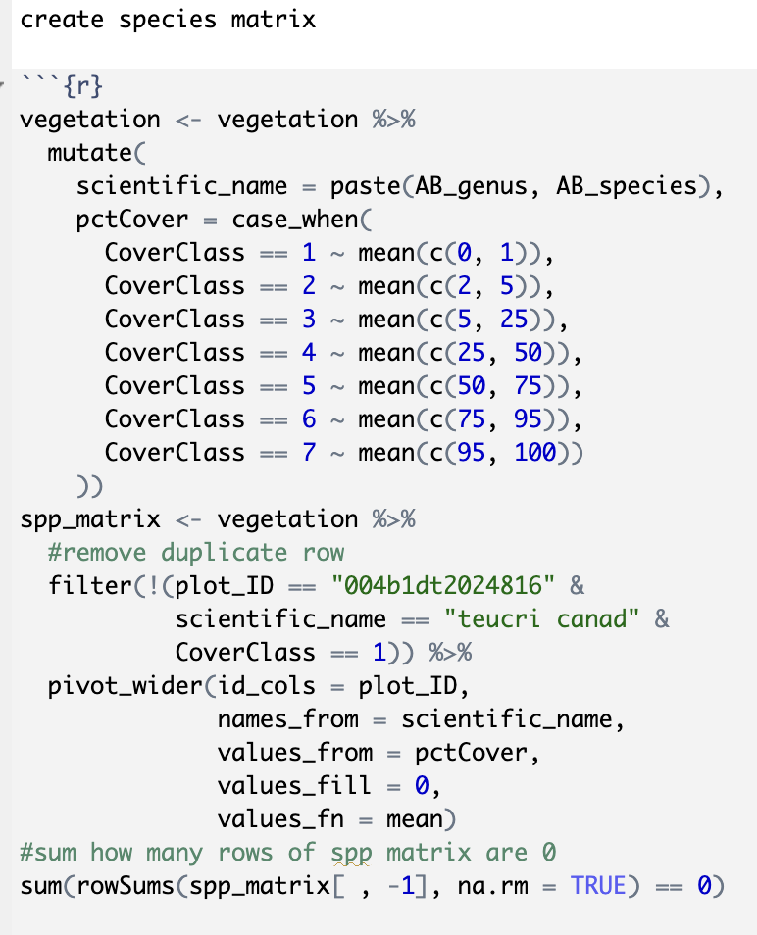
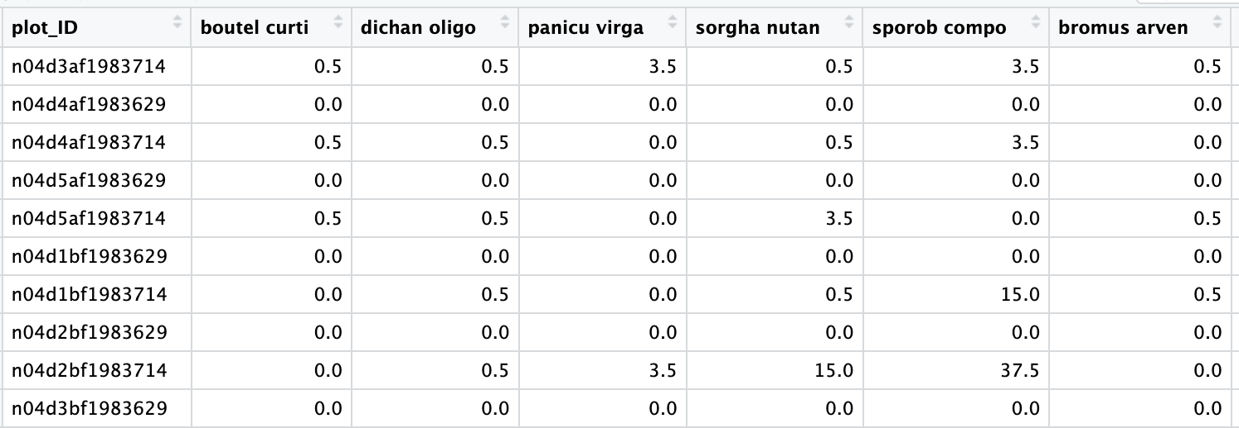
Data Wrangling: Script 1
scientific_name
pctCover

Slide 10
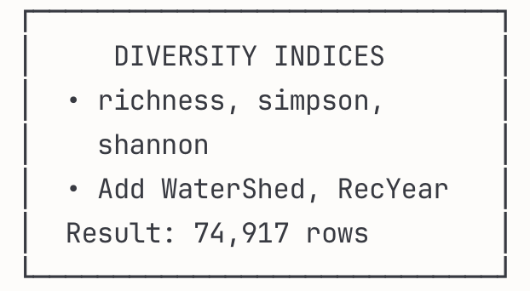
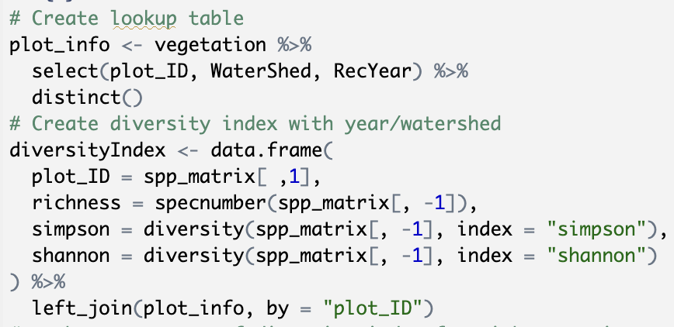
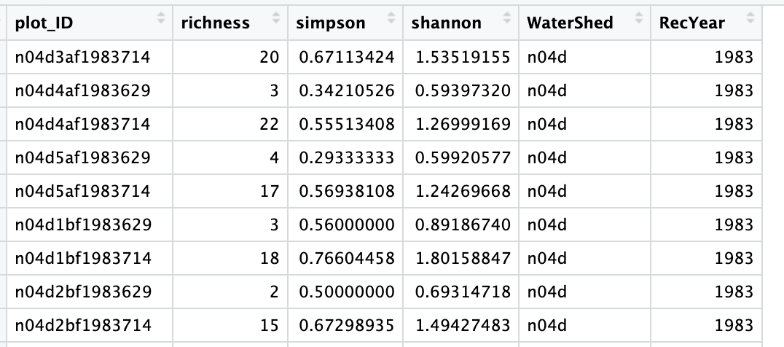
Data Wrangling: Script 1
Richness: Total count of unique species in a community
Shannon Index: Diversity measure accounting for species abundance and evenness
Simpson Index: Probability-based metric emphasizing species evenness

Slide 11
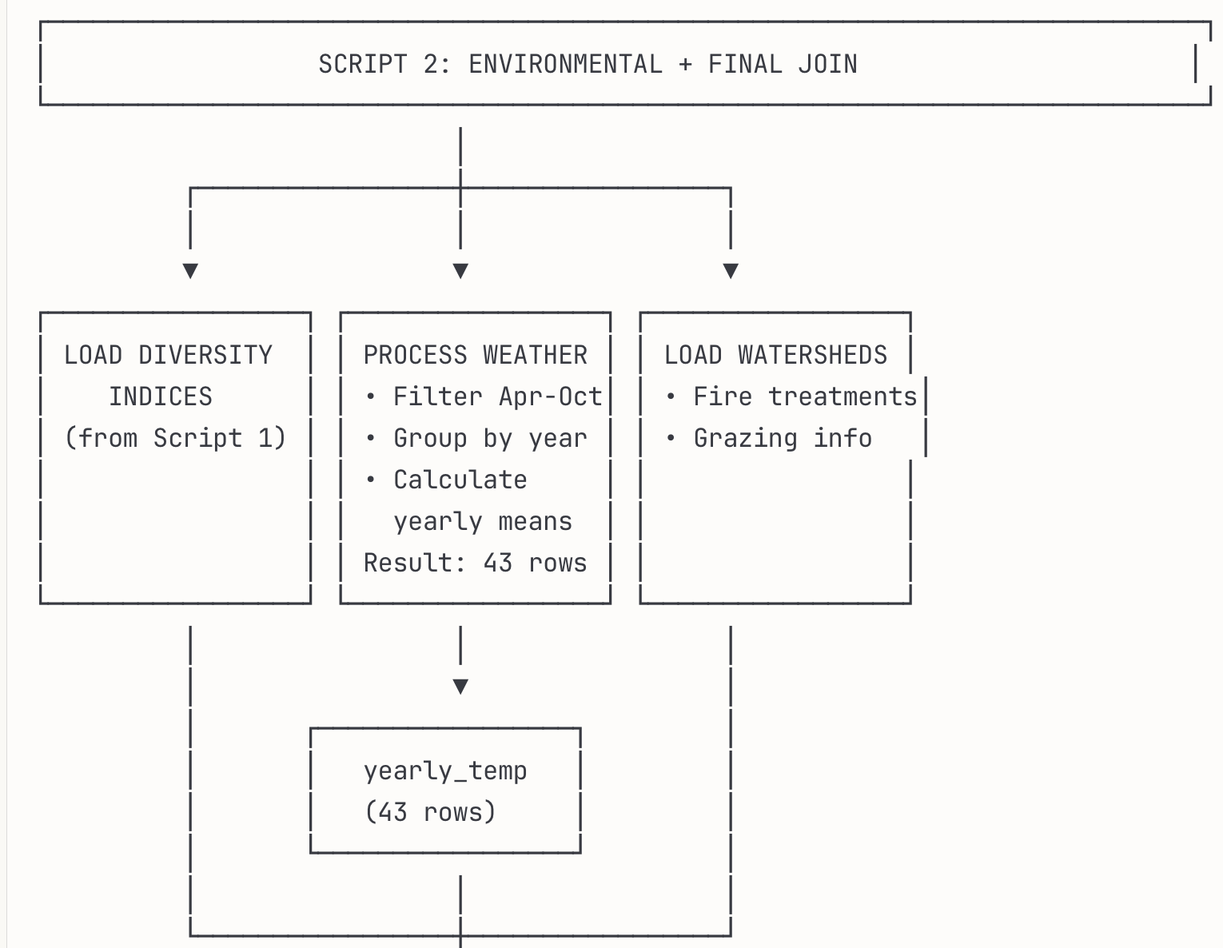
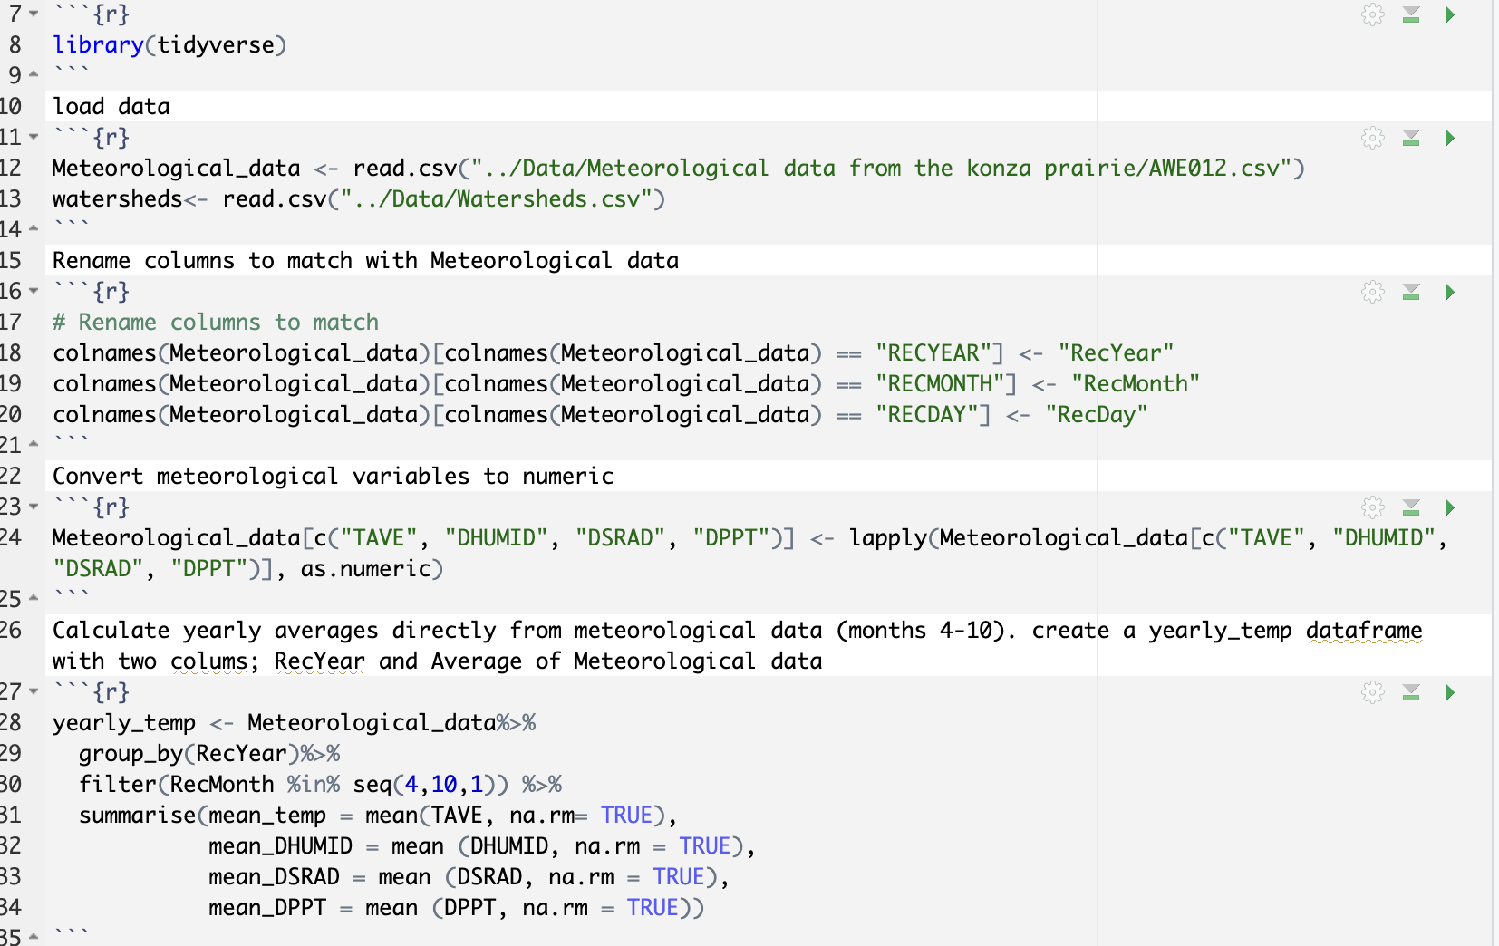
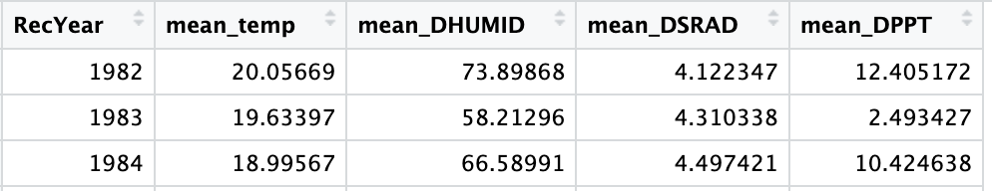
Data Wrangling: Script 2
Next slide
Next slide

Slide 12
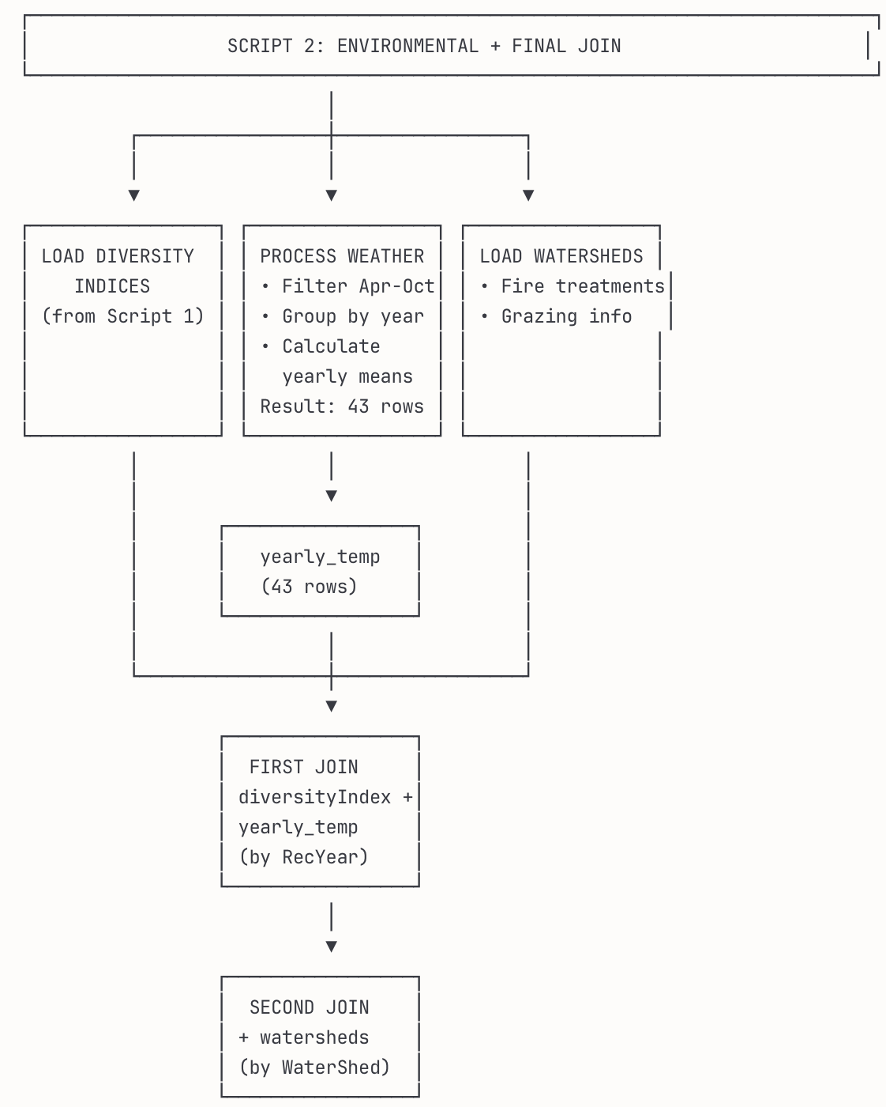
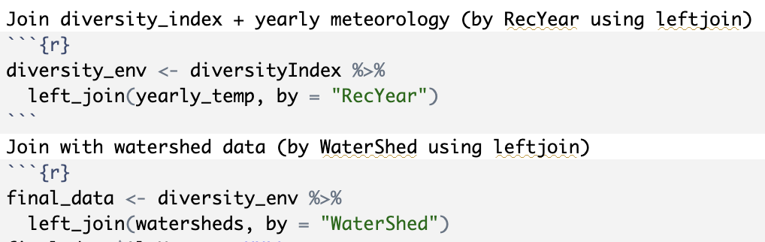
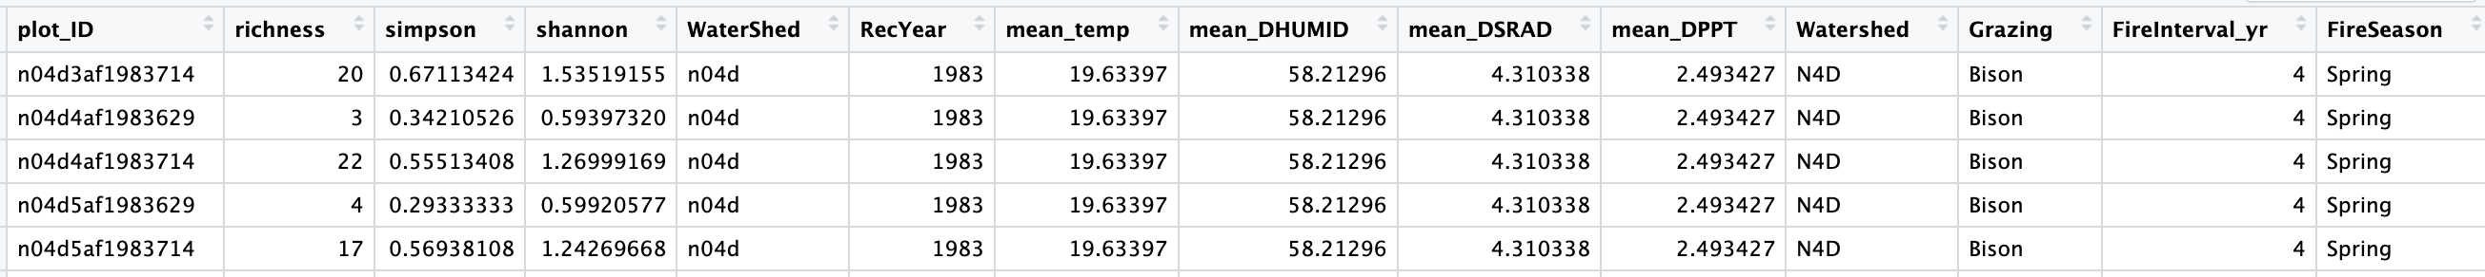
Data Wrangling: Script 2

Slide 13
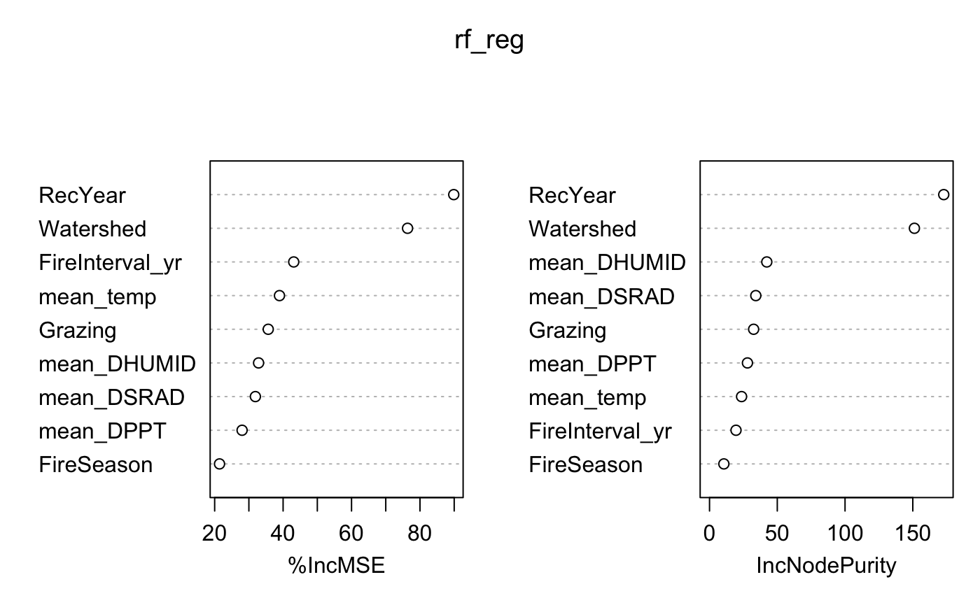
Result Analysis: Simpson response variable
Simpson diversity measures how diverse a plant community is by considering both the number of different species and how evenly they are distributed. Unlike just counting species, Simpson gives higher scores when no single species dominates the area.
%IncMSE :
%IncMSE = Percent Increase in Mean Squared Error when a variable is randomly shuffled
Higher values = more important variables for predicting diversity
Shows how much prediction accuracy drops when that variable is removed
Key Findings from the Plot:
RecYear - Most important predictor (~80% IncMSE)
Simpson diversity changes significantly over the study period
Watershed - Second most important (~60% IncMSE)
Different watersheds have distinct Simpson diversity patterns
FireInterval_yr - Moderate importance (~40% IncMSE)
Fire frequency affects species balance and community evenness
Mean of squared residuals: 0.02492281 % Var explained: 19.52
Fig: Important Factors for Plant Diversity (Simpson Index)

Slide 14
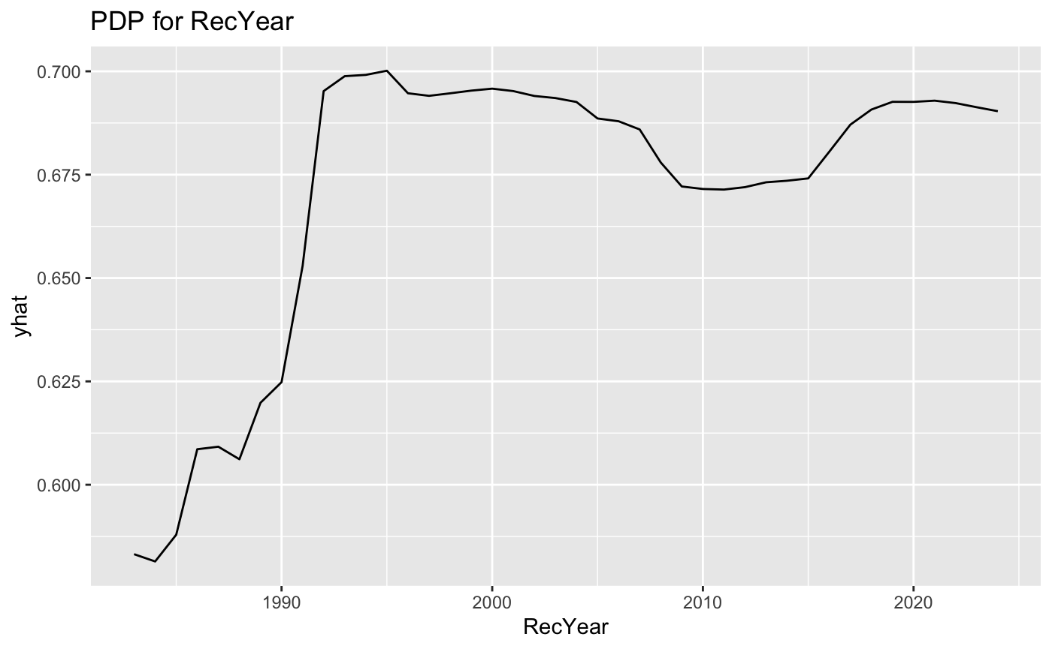
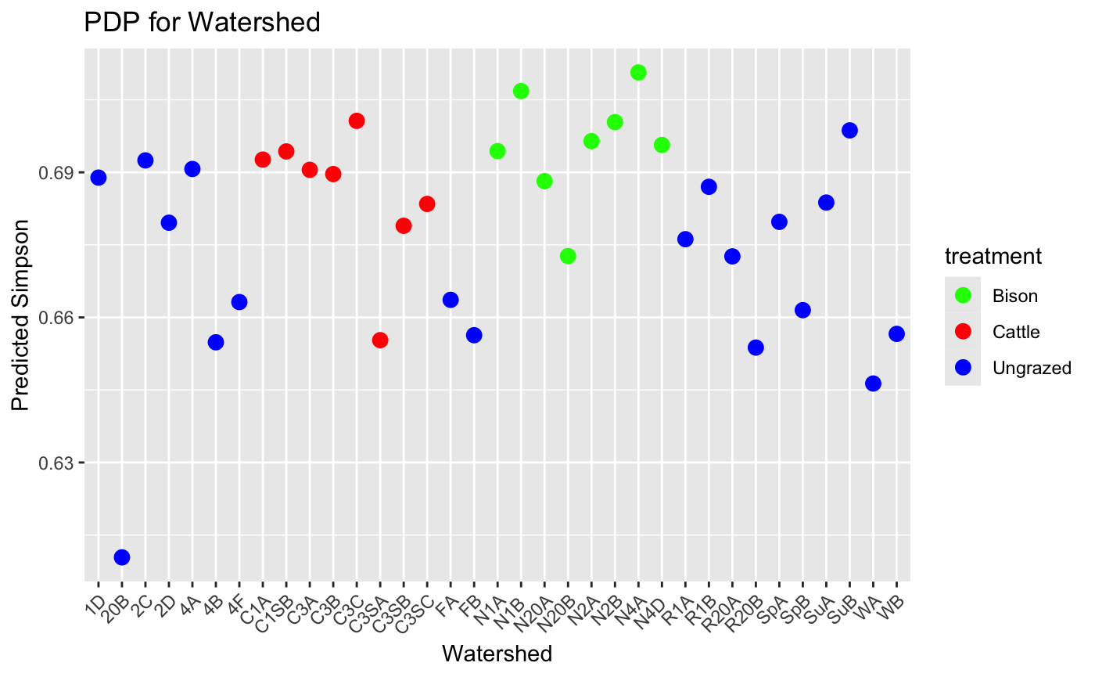
Result Analysis: Simpson response variable
PDP (Partial Dependency Plot):
Shows how each variable affects Simpson diversity when other factors are held constant
Reveals pure effect of individual predictors on plant diversity
Fig: Simpson Diversity: Time and Watershed Effects with PDP Analysis

Slide 15
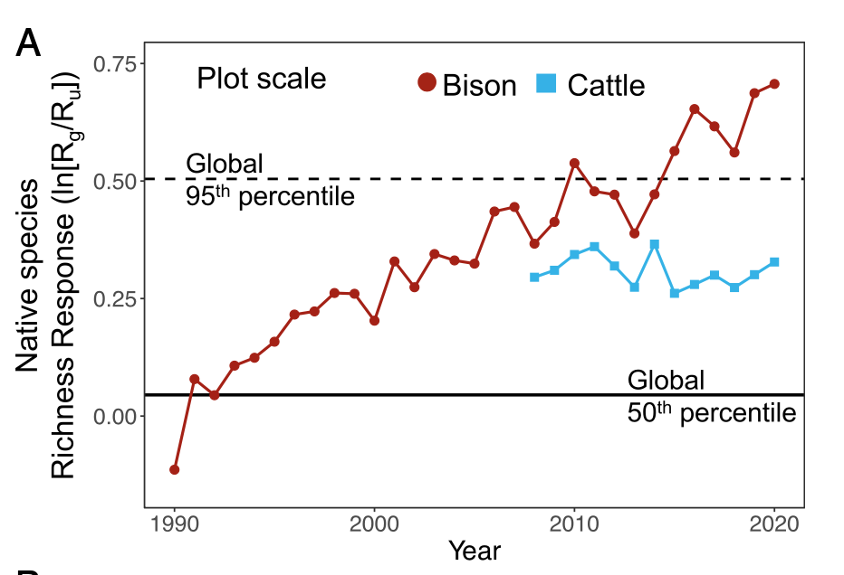
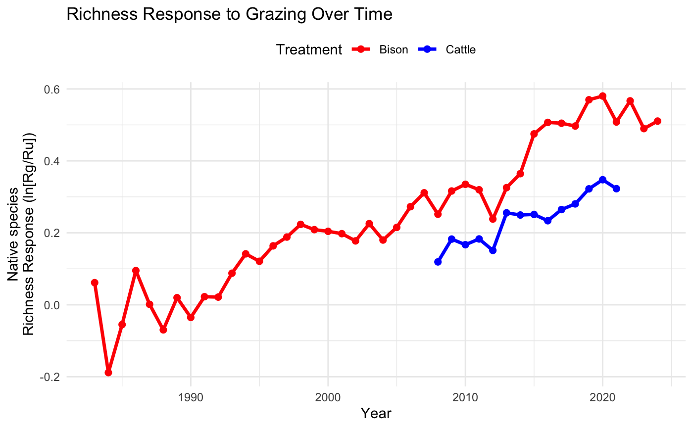
Result Analysis: Richness Response (comparison with paper)
Fig: From Paper Analysis (4 Watersheds)
Fig: From our Analysis (39 Watersheds)

Slide 16

Thank you

